Slide 1




Slide 2
How to express.
Ability.
Permission.
Advice.
Obligation.
Possibility.

Slide 3


Slide 4
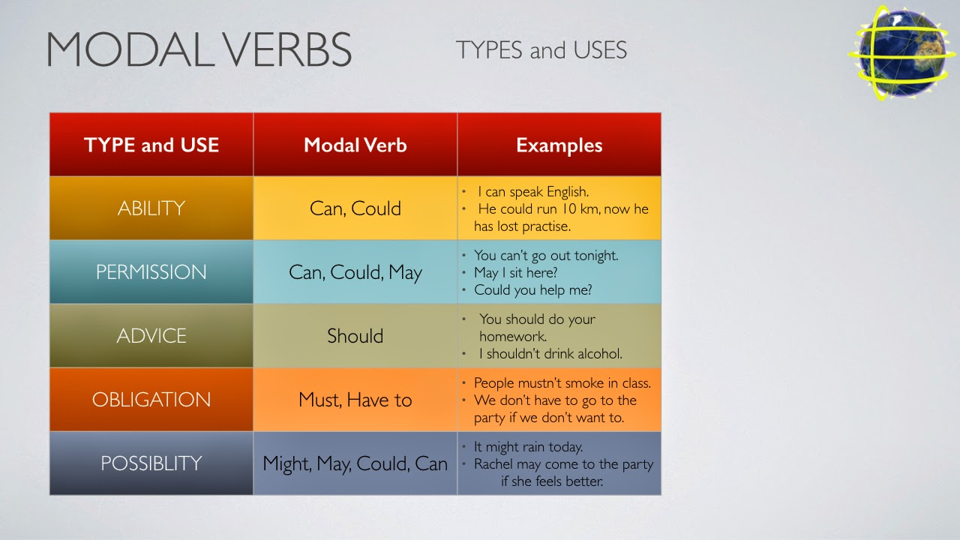

Slide 5

You have 10 minutes to create at least 1 sentence
For each use of modal verbs.
The, you will share them with the class.
PS: You can use, your current situation, for example; “I must write an essay for Friday, I might do it today, but I’m not sure.”

Slide 6

We will put ourselves in a couple of hypothetical situations.
You should be able to:
give an advice.
ask for permission
demand somebody to do something.

Slide 7


Slide 8

We learned that modal verbs are use for;

